Slide 1
Lego EV3 Programming

Slide 2
Flow Control
Wait
Loop
Switch (at a later class)

Slide 3
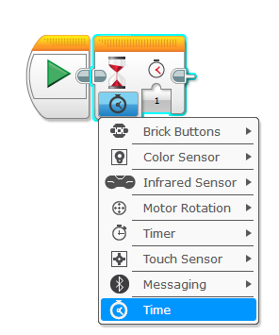
Wait Block
You can wait for a specific time, or for some specific action

Slide 4
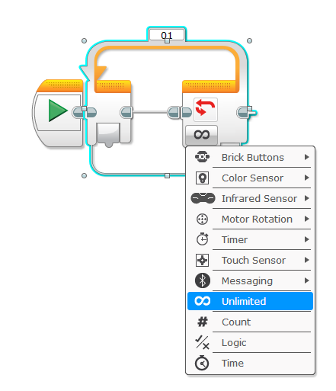
Loops
Loop name
Repeat some commands a certain amount, can be unlimited, or until a condition is met.

Slide 5
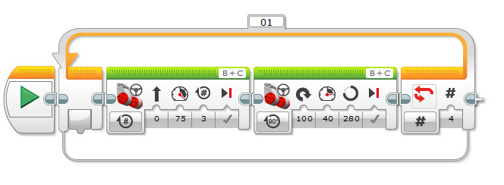
Example

Slide 6
Nested Loops

Slide 7
My Blocks
You can make your own blocks to do “functions” that you create.

Slide 8
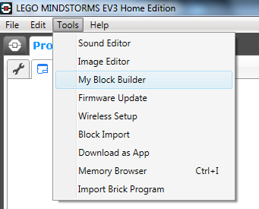

Slide 9
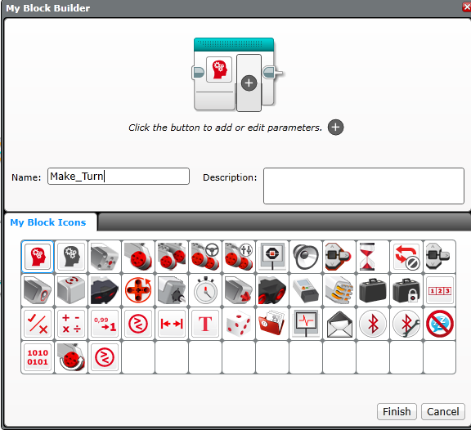

Slide 10
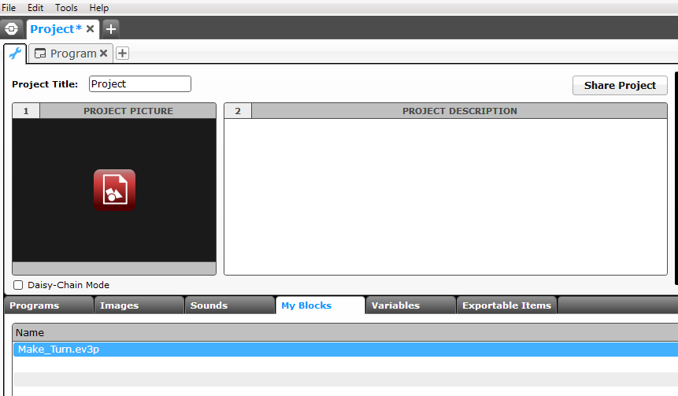

Slide 11
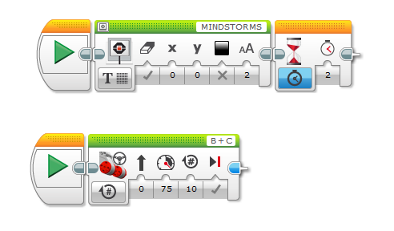
Multitasking

Slide 12
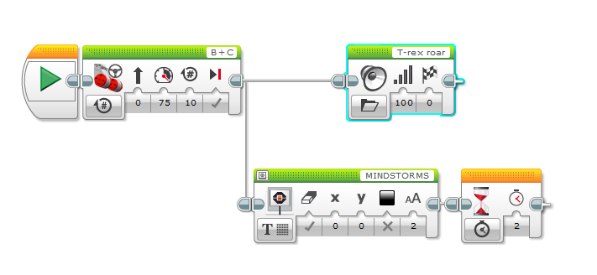
Split Task

